Slide 1
DBSP: Automatic Incremental View Maintenance for Rich Query Languages
Mihai Budiu, Leonid Ryzhyk - VMWare Research
Frank McSherry – Materialize.io
Val Tannen – University of Pennsylvania
July 7, 2022
Relational.AI

Slide 2

Brief History
Differential Dataflow (DD): a framework for incremental computation (Murray, McSherry, et al, SOSP 2013) https://github.com/TimelyDataflow/differential-dataflow
Differential Datalog (DDlog): a programming language for incremental computation (VMware Research, 2019), built on DD https://github.com/vmware/differential-datalog/
DBSP: formalize Differential Datalog (2021) https://github.com/vmware/database-stream-processor, https://arxiv.org/abs/2203.16684

Slide 3

Abstract
A simple language called DBSP
Four (4) operators
Based on Digital Signal Processing (DSP)
A formal definition of incremental computation in DBSP
An algorithm converting an arbitrary DBSP program to an incremental DBSP program
A recipe implementing DB queries in DBSP
https://arxiv.org/abs/2203.16684

Slide 4
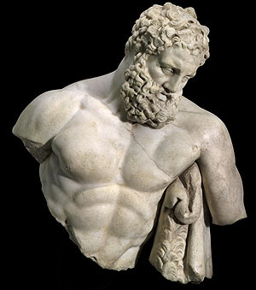
DBSP is powerful
It can model a rich class of database queries:
Relational (select, project, join, union, difference)
Computations on sets, bags, multisets
Nested relations (group-by, flatmap)
Aggregation
Recursion (monotonic and non-monotonic)
Stratified negation
Streaming computations (joins, window aggregates)
Relational while queries
More?
Corollary: we get automatically incremental evaluation for all these
The bold ones are new theoretical results in DD/DBSP
SQL
Datalog
CQL

Slide 5

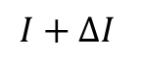
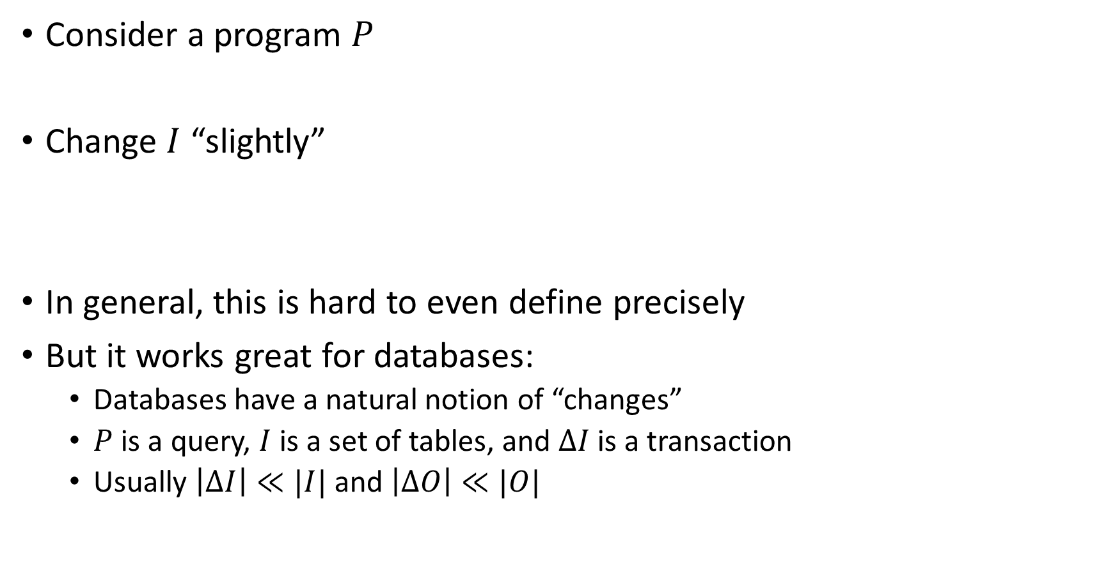
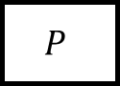
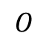
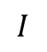
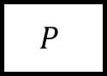
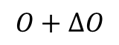
What is incremental computation?
Consider a program $P$
Change $I$ “slightly”
In general, this is hard to even define precisely
But it works great for databases:
Databases have a natural notion of “changes”
$P$ is a query, $I$ is a set of tables, and $ΔI$ is a transaction
Usually $\left|ΔI\right|≪|I|$ and $\left|ΔO\right|≪|O|$
$$I$$
$$P$$
$$O$$
reuse
$$I+ΔI$$
$$P$$
$$O+ΔO$$

Slide 6

Outline
Stream computations
Incremental computation
Optimizing incremental circuits
Implementing queries in DBSP

Slide 7
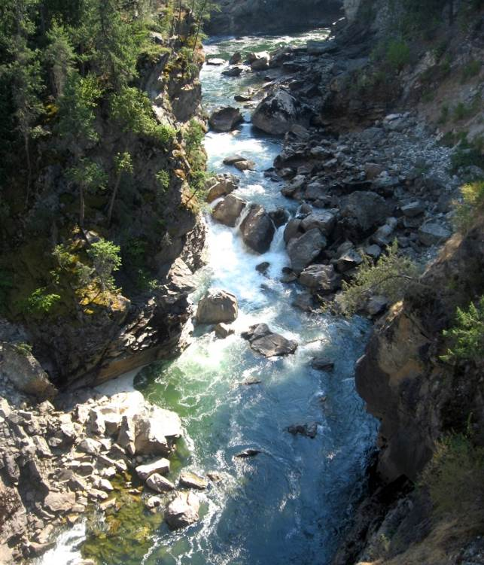
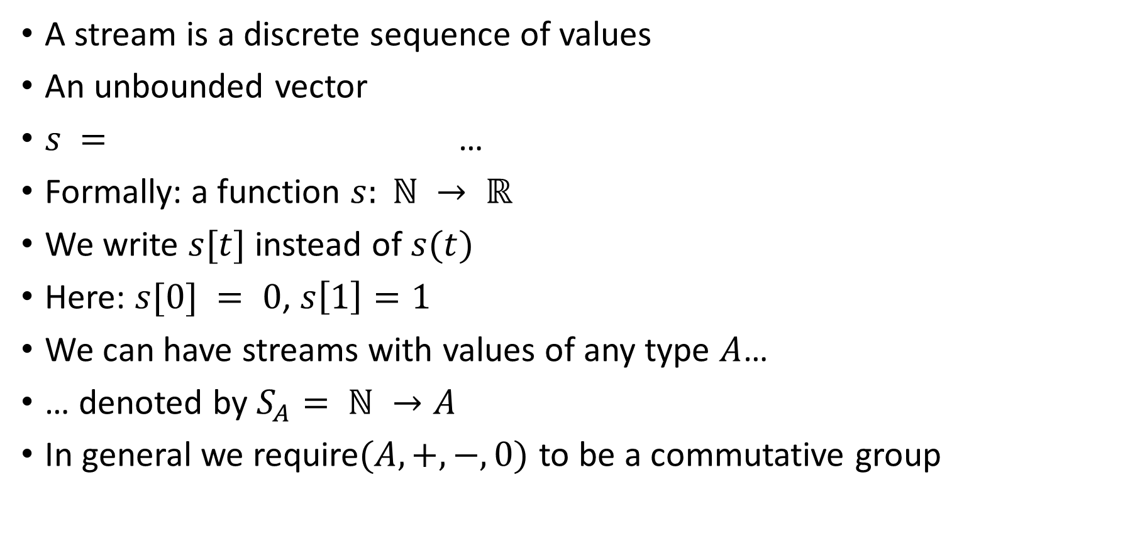
Streams
A stream is a discrete sequence of values
An unbounded vector
$s =$ …
Formally: a function $s: ℕ → ℝ$
We write $s[t]$instead of $s(t)$
Here: $s[0] = 0$, $s\left[1\right]=1$
We can have streams with values of any type $A$…
… denoted by $S_{A}= ℕ →A$
In general we require$(A, +, −, 0)$ to be a commutative group
0
1
2
1
0
-1
-2
-1

Slide 8
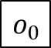
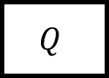
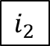
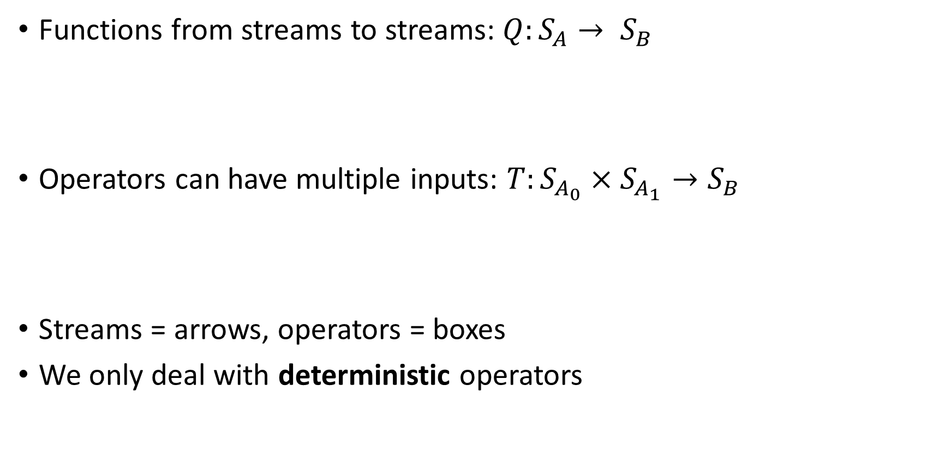
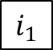
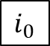
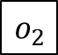
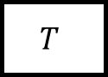
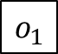
Stream operators
Functions from streams to streams:$Q:S_{A}→ S_{B}$
Operators can have multiple inputs: $T:S_{A_{0}}×S_{A_{1}}→S_{B}$
Streams = arrows, operators = boxes
We only deal with deterministic operators
$$i_{0}$$
$$i_{1}$$
$$i_{2}$$
…
$$Q$$
$$o_{0}$$
$$o_{1}$$
$$o_{2}$$
…
…
$$T$$
…
…

Slide 9
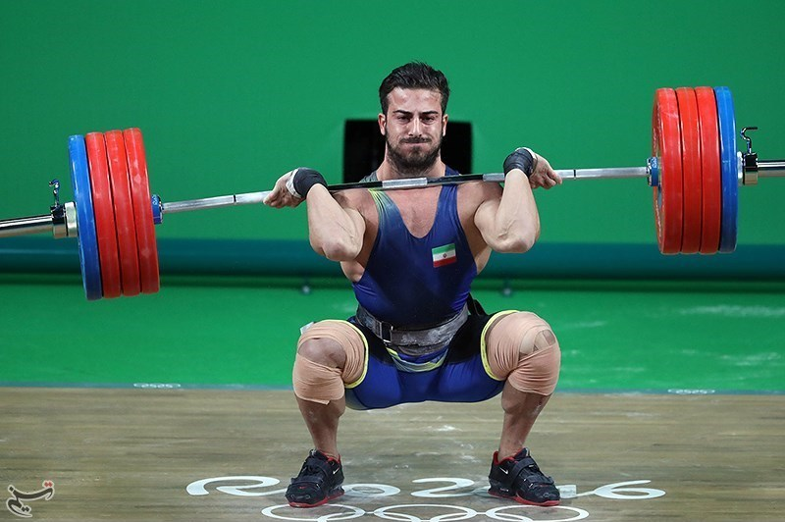
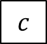
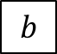
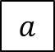
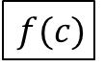
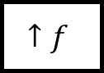
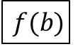
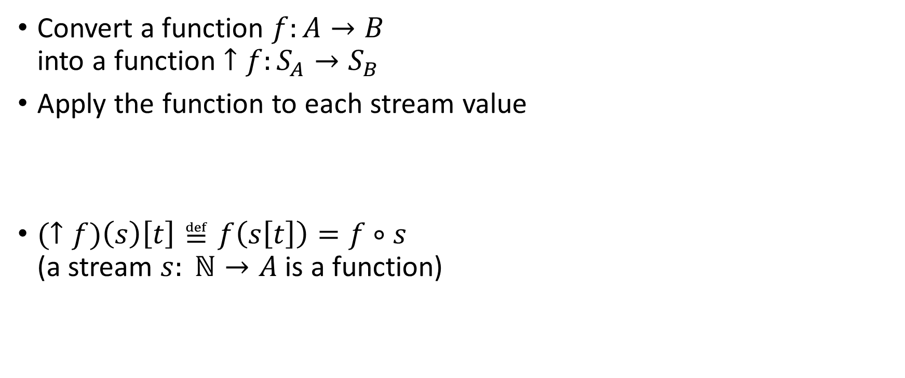
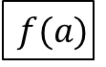
Lifting
Convert a function $f:A→B$ into a function $↑f:S_{A}→S_{B}$
Apply the function to each stream value
$(↑f)\left(s\right)\left[t\right]≝f\left(s\left[t\right]\right)=f∘s$ (a stream $s: ℕ→A$ is a function)
$$a$$
$$b$$
$$c$$
…
$$↑f$$
$$f(a)$$
$$f(b)$$
$$f(c)$$
…

Slide 10
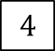

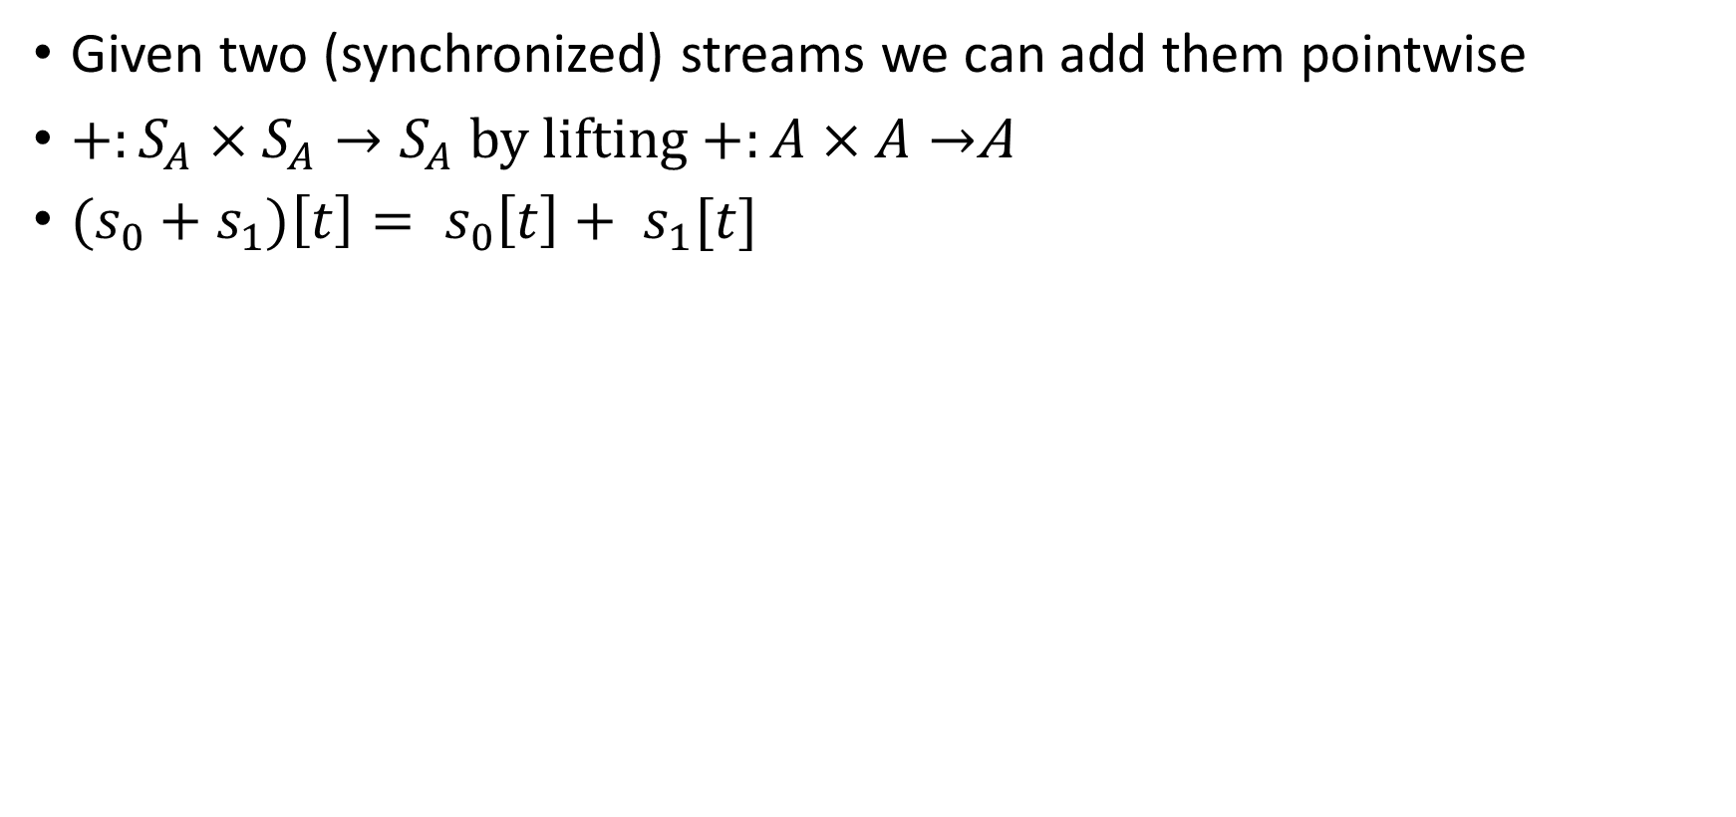

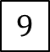

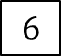

Addition
Given two (synchronized) streams we can add them pointwise
$+:S_{A}×S_{A}→S_{A}$ by lifting $+:A×A→$A
${(s}_{0} + s_{1})\left[t\right]= s_{0}\left[t\right]+ s_{1}[t]$
$$1$$
$$2$$
$$3$$
…
+
5
7
$$9$$
…
$$4$$
$$5$$
$$6$$
…

Slide 11
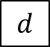
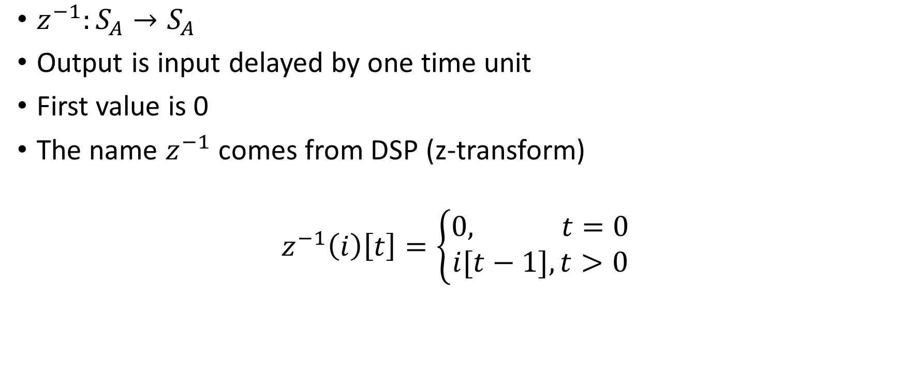
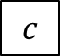
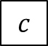

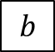
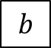
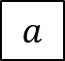
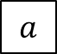
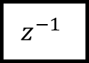

Delay ($z^{−1}$ )
$z^{−1}:S_{A}→S_{A}$
Output is input delayed by one time unit
First value is 0
The name $z^{−1}$ comes from DSP (z-transform)
$$z^{−1}\left(i\right)\left[t\right]=\left\{\begin{aligned}0, t=0 \\ &i[t−1], t>0\end{aligned}\right.$$
$$a$$
$$b$$
$$c$$
$$d$$
…
$$z^{−1}$$
$$0$$
$$a$$
$$b$$
$$c$$
…

Slide 12
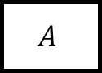
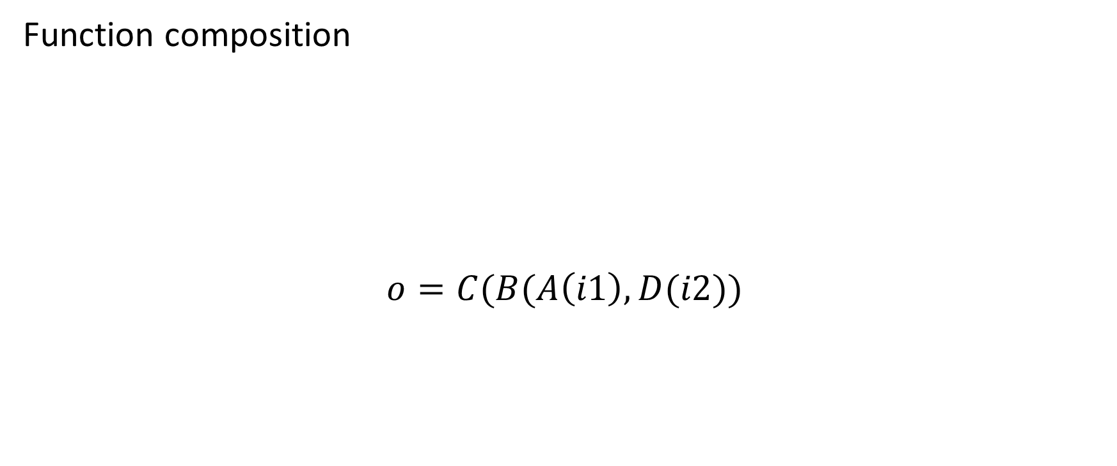
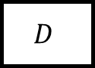
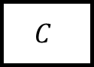
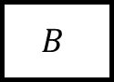
Chaining operators into circuits
Function composition
$$o=C(B(A\left(i1\right), D(i2))$$
i1
$$A$$
$$B$$
$$C$$
o
i2
$$D$$

Slide 13

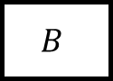
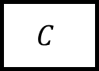
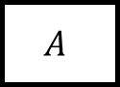
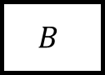


Circuit equivalence
Two circuits are equivalent iff they compute the same result given the same inputs
Function composition is associative => these circuits are equivalent:
$$A$$
$$B$$
$$C$$
$$⇔$$
$$A$$
$$B$$
$$C$$

Slide 14


Time-invariance
A stream operator $T$ is time-invariant if does not “depend on time”
i.e., if you delay the input, you get a delayed output
i.e., these two circuits equivalent:
DBSP only uses time-invariant operators
Example which is not time-invariant: $Q\left(s\right)\left[t\right]= s\left[t\right]+ t mod 2$

Slide 15


Causal operators
Operator $Q$ is causal if $Q(i)[t]$ only depends on $i\left[0\right]… i\left[t\right]$ (past and present inputs) and not on $i[t+1]$, … (future inputs)
DBSP operators are causal

Slide 16












Differentiation
What does this circuit compute?
$o\left[t\right]=s\left[t\right]–s\left[t−1\right]$
$o\left[0\right]=s\left[0\right]$
o is the derivative of the stream $s$ (as a function of time)
o
Denote this circuit by $D:S_{A}→S_{A}$
o is the stream of changes of s
$$1$$
$$2$$
$$3$$
$$2$$
…
$$D$$
$$1$$
$$1$$
$$1$$
$$−1$$
…
stream of changes

Slide 17











Integration
Denote this operator by $I: S_{A}→S_{A}$
If s is a stream of changes…
… then o is the original stream
What does this circuit compute?
This looks weird: o is recursively defined!
But it is well-defined
$o[0] =s[0]$
$o[t] =s[t] + o[t−1]$
Has a unique solution: $o\left[t\right]=\sum_{k=0}^{t}{s\left[t\right]}$
$o$ is the integral of $s$
o
$$1$$
$$1$$
$$1$$
$$−1$$
…
$$I$$
$$1$$
$$2$$
3
$$2$$
…
stream of changes

Slide 18

Some properties
$I$ and $D$ are
deterministic
causal
time-invariant
Theorem: $I∘D=D∘I=id$ (or $I=D^{−1}$)

Slide 19


Linear operators
A unary stream operator $Q:S_{A}→S_{B}$ is linear if:
$$Q\left(s+t\right)=Q\left(s\right)+Q\left(t\right)$$
Theorem: $−$, $I$, $D$, $z^{−1}$ are linear

Slide 20

Bilinear operators
A binary operator $⋈:S_{A}×S_{A}→S_{A}$ is bilinear if it distributes over addition
$$\left(s+t\right)⋈u=(s⋈u)+(t⋈u)$$
$$s⋈\left(u+v\right)=(s⋈u)+(s⋈v)$$
Example: lifted multiplication: $T\left(s,u\right)\left[t\right]=s\left[t\right]⋅u[t]$

Slide 21


Streams are groups
Theorem: If $A$is a commutative group, $SA$ is a commutative group

Slide 22
Outline
Stream computations
Incremental computation
Optimizing incremental circuits
Implementing queries in DBSP

Slide 23










All databases are streaming databases!
Consider a database $DB$, a set of tables
A committed transaction is a change to $DB$
The set of linearized transactions define $T,$ a stream of changes to $DB$
$T[t]$is the $t$-th transaction
$DB$ is a stream of database snapshots
$DB[t]$ is the contents of the database after $t$ transactions have been executed
We have: $DB[t] = I(T(t))$ – the integral of the transaction stream
$$T_{0}$$
$$T_{1}$$
$$T_{2}$$
$$T_{3}$$
…
$$I$$
$${DB}_{0}$$
$${DB}_{1}$$
$${DB}_{2}$$
$${DB}_{3}$$
…

Slide 24












Views
Let $Q$ be a query defining a view $V$ as a function of the database, e.g.:
CREATE VIEW V AS SELECT * FROM T WHERE Age >= 10
$V[t]=Q\left(DB[t]\right)$
$V$ is a stream of view snapshots:
$$V= ↑Q(DB)$$
$$↑Q$$
$$V_{0}$$
$$V_{1}$$
$$V_{2}$$
$$V_{3}$$
…
Versions of $V$
Versions of $DB$
$${DB}_{0}$$
$${DB}_{1}$$
$${DB}_{2}$$
$${DB}_{3}$$
…

Slide 25













Incremental view maintenance
The incremental maintenance of $V$ is performed by
${(↑Q)}^{Δ}≝ D∘(↑Q)∘I$
$${(↑Q)}^{Δ}$$
$$T_{0}$$
$$T_{1}$$
$$T_{2}$$
$$T_{3}$$
…
$$I$$
$$↑Q$$
D
$$ΔV_{0}$$
$$ΔV_{1}$$
$$ΔV_{2}$$
$$ΔV_{3}$$
…
Changes to $DB$
Changes to $V$
$$V_{0}$$
$$V_{1}$$
$$V_{2}$$
$$V_{3}$$
…
Versions of $V$
Versions of $DB$
$${DB}_{0}$$
$${DB}_{1}$$
$${DB}_{2}$$
$${DB}_{3}$$
…

Slide 26



Multiple inputs
This generalizes to operators with multiple inputs or outputs
E.g., for a binary stream operator $T:S_{A_{0}}×S_{A_{1}}→S_{B}$
$$T^{Δ}$$

Slide 27


Fundamental Equation of Incremental View Maintenance
$$Q^{Δ}=D∘Q∘I$$
Defined even for streaming queries $Q$ (not lifted)
As written, $Q^{Δ}$ is expensive to compute
However, we can often optimize the computation significantly
Notice: we don’t need $\frac{dQ(s)}{ds}$!

Slide 28










Incremental queries are streaming systems
$${Δi}_{0}$$
$${Δi}_{1}$$
$${Δi}_{2}$$
$${Δi}_{3}$$
…
$$Q^{Δ}$$
$$Δo_{0}$$
$$Δo_{1}$$
$$Δo_{2}$$
$$Δo_{3}$$
…
state
$Q^{Δ}$ is a streaming system:
it runs forever
it has internal state (even if $Q$ is stateless)

Slide 29
Outline
Stream computations
Incremental computation
Optimizing incremental circuits
Implementing queries in DBSP

Slide 30
























Linear operators
Theorem: For a linear stream operator $Q$ we have $Q=Q^{Δ}$
(most operators used in DB queries are linear)
Why is this better?
Incremental operators compute over changes; assume $\left|T\left[t\right]\right|≪|DB[t]|$
Original:
Optimized:
A speedup of $O(\left|DB\right|/|T|)$
$$T_{0}$$
$$T_{1}$$
$$T_{2}$$
$$T_{3}$$
…
$$I$$
$$Q$$
D
$$ΔV_{0}$$
$$ΔV_{1}$$
$$ΔV_{2}$$
$$ΔV_{3}$$
…
$${DB}_{0}$$
$${DB}_{1}$$
$${DB}_{2}$$
$${DB}_{3}$$
…
$$T_{0}$$
$$T_{1}$$
$$T_{2}$$
$$T_{3}$$
…
$$Q$$
$$ΔV_{0}$$
$$ΔV_{1}$$
$$ΔV_{2}$$
$$ΔV_{3}$$
…

Slide 31

Example of a linear query
CREATE VIEW V AS SELECT * FROM T WHERE Age >= 10
You don’t need to know what’s in T to compute the changes to V
If you change T by adding $Δ$T…
…this (same) query computes $Δ$V:
SELECT DISTINCT * FROM $Δ$T WHERE Age >= 10

Slide 32






The chain rule (structural recursion)
$$(Q_{2}{∘Q_{1})}^{Δ}=Q_{2}^{Δ}∘Q_{1}^{Δ}$$
Proof by pictures:
We can incrementalize a complex circuit by incrementalizing each component independently
For a chain of linear operators: $(Q_{2}{∘Q_{1})}^{Δ}=Q_{2}^{Δ}∘Q_{1}^{Δ}=Q_{2}∘Q_{1}$
$$⇔$$
$$⇔$$
$$⇔$$

Slide 33



Bilinear operators
(Lifted) join, intersection, Cartesian product
From distributivity:$Δ\left(A×B\right)=\left(A×ΔB\right)+\left(ΔA×B\right)+\left(ΔA×ΔB\right)$
Speed-up is $O(\frac{\left|A\right|}{\left|ΔA\right|}+\frac{\left|B\right|}{\left|ΔB\right|})$
$$⇔$$

Slide 34



The cycle rule
$$⇔$$
Allows us to recursively incrementalize circuits with feedback
All our circuits are built from:
Sequential composition
Feedback loops
We get a structural recursion scheme for incrementalizing any circuit

Slide 35
Outline
Stream computations
Incremental computation
Optimizing incremental circuits
Implementing Queries in DBSP

Slide 36

Computing on tables
SQL queries are functions from tables to tables: $$Q:T_{0}×…×T_{n}→T$$
T
Query
Query result
Name | Age
Mike | 10
John | 12
Amy | 8
Chris | 10
Name | Age
Mike | 10
John | 12
Chris | 10
SELECT * FROM T WHERE Age >= 10

Slide 37

Hold on! This is not well-defined!
The definitions of $I$, $D$ require streams over a commutative group
However, tables (sets, multisets) are not groups
E.g., there is no table negation
Solution:
Generalize tables to obtain a commutative group

Slide 38


$ℤ$-sets (also called $ℤ$-relations)
Generalize sets so that each element has an integer weight
The weight can be positive, zero, or negative
$ℤ$-set = key-value map:
Key = tuple
Value = weight
Formally: a $ℤ$-set is a function $r: T→ℤ$
$T$ is the type of the tuples
With finite support (finite number of rows)
Name | Age | Weight
Mike | 10 | 1
John | 12 | 3
Amy | 8 | -1
Chris | 10 | 2
tuples

Slide 39



$ℤ$-sets are yummy!
Can represent both tables and changes to tables
Positive weights = elements added
Negative weights = elements removed
Generalize sets and multisets
Classic DB table = $ℤ$-set where all weights are 1
Form a commutative group (because $ℤ$ is a group)

Slide 40

$ℤ$-set addition
Name | Weight
Mike | 1
John | 3
Amy | -1
Chris | 2
Name | Weight
Mike | -1
Dan | 1
Chris | 1
Name | Weight
Dan | 1
John | 3
Amy | -1
Chris | 3
+
=

Slide 41


The distinct operator
“Converts” a $ℤ$-set into a set
$distinct\left(r\right)\left[t\right]= \left\{\begin{aligned}1 if r\left[t\right]>0 \\ 0 otherwise\end{aligned}\right.$
Name | Weight
Dan | 1
John | 3
Amy | -1
Chris | 3
Name | Weight
Dan | 1
John | 1
Chris | 1
$$distinct\left( \right)=$$

Slide 42
Multiset union (can have duplicates)
SELECT * FROM T1 UNION ALL SELECT * FROM T2
T1
+
V
T2

Slide 43

Set union (no duplicates)
SELECT * FROM T1 UNION SELECT * FROM T2
T1
+
$$distinct$$
V
T2

Slide 44

Set difference
SELECT * FROM T1 EXCEPT SELECT * FROM T2
T1
+
$$distinct$$
V
T2
-
Recall: distinct removes elements with negative weights

Slide 45


Query composition
SELECT … FROM (SELECT … FROM T)
T
$$Q_{1}$$
$$Q_{2}$$
V
Query composition is circuit chaining (function composition).

Slide 46



Relational algebra using $ℤ$-set operations
Recursively defined on query structure
Many operations require a $distinct$
The other operations are all linear or bilinear

Slide 47

Incremental view maintenance recipe:
Translate recursively a DB query into a circuit $Q$ on $ℤ$-sets
1.5 Eliminate some distinct calls
Lift circuit to compute on streams: $↑Q$
Build incremental version of lifted circuit:
$${(↑Q)}^{Δ}≝D∘↑Q∘I$$
Optimize $Q^{Δ}$:
$$(Q{∘R)}^{Δ}=Q^{Δ}∘R^{Δ}$$

Slide 48



Definition of Differential Datalog
The Differential Datalog compiler
receives as input a query $Q$, written in Datalog
Produces as output an implementation of ${(↑Q)}^{Δ}$, written in Rust
stream of input changes
DDLog
program
DDlog compiler
Rust
Program
$${(↑Q)}^{Δ}$$
Rust compiler
Native library
$$Q$$
stream of output changes
Differential dataflow
library

Slide 49




Optimizing distinct
Distinct is idempotent: $distinct∘distinct=distinct$
For many relational queries $Q$ the following holds ($Q$ one of select, project, join, map, flatmap, union, intersection)
For Q in join, product, filter, select we have
$$⇔$$
$$⇔$$

Slide 50



Incremental distinct
$$⇔$$
Work proportional to $|d|!$

Slide 51

Complex Relational Example
CREATE VIEW V AS SELECT DISTINCT a.x, b.y FROM ( SELECT t1.x , t1.id FROM t1 WHERE t1.a > 2 ) a JOIN ( SELECT t2.id , t2.y FROM t2 WHERE t2.s > 5 ) b ON a.id = b.id
Inputs and outputs are collections, not streams

Slide 52



Example: Remove distinct calls
⬄
⬄
⬄

Slide 53


Example: Lift and incrementalize
Inputs and outputs are streams
Inputs and outputs are streams of changes

Slide 54


Example: optimize incremental circuit
Chain rule and linearity
Expand join and distinct

Slide 55

Recursive computations
Datalog
Reach(x, y) :- Edge(x, z), Reach(z, y).
The implementation iterates until convergence.
We introduce two new operators: $δ_{0}$ and $∫$
(“enter” and “exit”)

Slide 56


Creating streams from scalars
$$δ_{0}:A→S_{A}$$
$$δ_{0}\left(a\right)\left[t\right]≝\left\{\begin{aligned}a, t=0 \\ &0, t>0\end{aligned}\right.$$
Linear operator
scalar
stream
9
9, 0, 0, 0, 0, 0, …

Slide 57


Creating scalars from streams
Only defined for streams that are zero almost everywhere:
$$∫{ :S}_{A}→A$$
$$∫\left(s\right) ≝ \sum_{t≥0}{s\left[t\right]}$$
Linear operator
stream
scalar
1, 2, 3, 0, 0, 0, …
6

Slide 58



Simplest recursion scheme
O = R(I, O) where I and O are relations, and R is a query.
Implement non-recursive R as a circuit $R$
Lift circuit and connect feedback:
Theorem: O = $fix x.R\left(I, x\right).$
I

Slide 59


Semi-naïve evaluation
$$⇔$$
This proves the correctness of semi-naïve Datalog evaluation

Slide 60

Streaming incremental recursive queries
So far we have shown how to implement a recursive non-streaming query
To make it incremental we apply the same recipe as before, treating the non-streaming query as a black-box

Slide 61



Lifting a loop
The circuit can be treated as a scalar operator
So it can be lifted to operate on streams, like any other scalar operator
Theorem: lifting a circuit is the same a lifting every operator in the circuit
Works even when the circuit has feedback loops
$↑( )$=

Slide 62

Streams of Streams
$S_{A}$ is defined for any group $A$
$S_{A}$ itself is a group
$S_{S_{A}}$ is a group!
A “strange” operator

Slide 63

Streaming incremental recursive queries
Non-incremental streaming
recursive query
Incremental streaming
recursive query

Slide 64
Other operations we can model
Nested collections
Group-by (linear!)
Flatmap (linear!)
Aggregation (some aggregations, such as sum and count, are linear!)
Streaming joins
Relational while queries
We don’t have a characterization of the power of DBSP

Slide 65

Summary
DBSP circuits are a nice model of streaming computation
Four operators: $z^{−1}, ↑, δ_{0}, ∫$
Circuits can compute on $ℤ$-sets (changes to DBs)
Recipe for incremental view maintenance:
Translate a DB query into a circuit $Q$
Build incremental version of lifted circuit:
$${(↑Q)}^{Δ}≝D∘↑Q∘I$$
Optimize $Q^{Δ}$:
$$(Q{∘R)}^{Δ}=Q^{Δ}∘R^{Δ}$$

Slide 66
Extra slides

Slide 67

We’re only getting started!
Core DBSP library
Parallel and distributed execution
Formal verification
Persistence
Fault-tolerance
Load-balancing
Runtime queries
Cloud service
Integration in existing systems (SQL, Spark, Rust, etc.)
Applications

Slide 68




Streaming queries
Streaming joins
$t$ are changes to a table
$s$ is a stream
Table $I(t)$ is joined with every stream value in $s$
$o$ is also a stream
Convolutions
Standard DSP Finite-Impulse-Response filters
Streaming window queries
$θ$ is a stream of wall-clock values (time)
$s$ is a stream of timestamped data
$W$ window function, filters data in $s$ based on timestamp and time

Slide 69

Related work
Incremental View Maintenance
Streaming Databases
Streaming languages
Functional Languages
Category theory
Dataflow machines
Synchronous circuits

Slide 70


Materialized View Update Problem
We essentially cover this whole space
IEEE Data Engineering Bulletin, 1995

Slide 71
Datalog
Essentially an alternative language to SQL for describing views (Datalog views are always sets – no duplicates allowed)
Differential Datalog (DDlog) is a dialect of Datalog with extra features
CREATE VIEW V AS
SELECT DISTINCT * FROM T
WHERE Age >= 10
V(name, age) :- T(name, age), age >= 10.
SQL
Datalog

Slide 72
Set intersection
SELECT * FROM T1 INTERSECT SELECT * FROM T2
O(x) :- T1(x), T2(x).
This is a disguised JOIN. We will see it soon.

Slide 73






Projection
SELECT Age FROM T
In DDlog:
O(age) :- T(_, age).
The weight of $t$ = sum of weights of all tuples that project to $t$
$$π_{C}\left(m\right)\left[t\right]=\sum_{\begin{aligned}x∈m \\ π_{C\left(x\right)}=t\end{aligned}}{m[x]}$$
$$T$$
$${↑π}_{C}$$
$$distinct$$
$$V$$
Name | Age | Weight
Mike | 10 | 1
John | 12 | 3
Amy | 8 | -1
Chris | 10 | 2
Age | Weight
10 | 1+2
12 | 3
8 | -1
SELECT Age

Slide 74
Translating a DDlog rule
Rule head
Rule body
RelationHead :- RelationTerm0, not RelationTerm1.
Head relation = circuit output
Relations in body = circuit inputs
Rule body = circuit contents
Edges in circuit = conjunctions in rule body
Turnstyle = projection
Compiled to
RelationTerm0
proj
RelationHead
RelationTerm1

Slide 75
Selection (filtering)
SELECT * FROM T WHERE predicate
O(t) :- T(t), predicate(t).
Name | Age | Weight
Mike | 10 | 1
John | 12 | 3
Amy | 8 | -1
Chris | 10 | -2
Name | Age | Weight
Mike | 10 | 1
John | 12 | 3
Chris | 10 | -2
WHERE Age >= 10

Slide 76



Selection (filtering)
SELECT * FROM T WHERE predicate
V(t) :- T(t), predicate(t).
$$σ:ℤ\left[T\right]→ℤ[T]$$
$$σ\left(m\right)[t]=\left\{\begin{aligned}m\left[t\right], if predicate(t) \\ 0, otherwise\end{aligned}\right.$$
$$T$$
$$↑σ$$
V
$σ$ keeps all tuples for which the predicate is true.

Slide 77
Cartesian products
V(t1, t2) :- T1(t1), T2(t2).
SELECT T1.*, T2.* FROM T1, T2
Name | Age | Weight
Mike | 10 | 1
John | 10 | 3
Amy | 10 | -1
Chris | 10 | 2
Mike | 12 | 3
John | 12 | 9
Amy | 12 | -3
Chris | 12 | 6
Name | Weight
Mike | 1
John | 3
Amy | -1
Chris | 2
Age | Weight
10 | 1
12 | 3
x
=
Multiply weights.

Slide 78


Cartesian products
V(t1, t2) :- T1(t1), T2(t2).
SELECT T1.*, T1.* FROM T1, T2
$m_{1}∈ℤ\left[T_{1}\right],$ $m_{2}∈ℤ\left[T_{2}\right]$, ($m_{1}×m_{2})\left[\left(t_{1}, t_{2}\right)\right]≝m_{1}\left[t_{1}\right]⋅m_{2}\left[t_{2}\right]$
T1
$$↑×$$
V
T2

Slide 79


(Equi)Joins
SELECT Name, Age FROM T1 JOIN T2 ON T1.Name=T2.Name
O(Name, Age) :- T1(Name, Age), T2(Name, _).
T1
$$↑×$$
$$↑σ$$
V
T2
Cartesian product followed by filtering.

Slide 80


DSP Filters
Most circuits in DSP are composed of linear, time-invariant blocks
These have some very nice mathematical properties
In particular, their output is fully described by their response to an “impulse” (the stream 1,0,0,0…)
Given their impulse response R and an input signal S, the output is R * S – the convolution of R and S
$I$ is an IIR filter – Infinite Impulse Response (1,1,1,1,…)
$D$ is a FIR filter – Finite Impulse Response (1,-1,0,0,….)
However, many of the computations we will need are not linear
So most of the beautiful DSP theory does not apply

Slide 81


Relation to synchronous digital circuits
Combinational logic (acyclic graphs)
“Instantaneous” propagation
Flip-flops or latches (memory elements)
Clocked elements
Remember value from previous clock
This is our delay element $z^{−1}$
Sequential circuits
Combinational logic
All back-edges must go through a latch
clock
input
Combinational
circuit
output
state

Slide 82
Synchronous circuits ideas
The entire state is stored in latches
State summarizes the entire history of the circuit
State = checkpoint.
Optimizations such as retiming can be used to minimize state
Retiming moves around latches without changing the circuit semantics

Slide 83

DBSP vs Differential Dataflow
DBSP is inspired by DD
https://github.com/TimelyDataflow/differential-dataflow
DBSP is much simpler than DD
DD has the notion of “change” built-in
In DBSP the changes are obtained by using $D$ and $I$
DD is more general
DBSP requires that input changes are streamed in time order
In DD changes can be made at any time, not just in time order

Slide 84

Transitive closure
reach(x, y) :- edge(x, y).
reach(x, y) :- edge(x, z), reach(z, y).
edge
reach
edge
join(edge, reach)

Slide 85

Map
Given a function $f:A→B$ the operator map$\left(f\right):ℤ\left[A\right]→ ℤ[B]$ is defined as: map$\left(f\right)\left(i\right)=\sum_{x∈i}{i\left[x\right]⋅f(x)}$
Synthesized from DDlog programs such as O(v) :- I(x), var v = f(x).
The implementation lifts map$(f)$ to every element of a stream
Note: map$(f)$is linear for any function $f$

Slide 86

Aggregation
Aggregation functions such as SUM, COUNT are linear functions between $ℤ[ℝ]$ and $ℝ$
But not between $ℤ[ℝ]$ and $ℤ[ℝ]$!
SELECT SUM(c) FROM I
makeset converts a $ℝ$scalar into a singleton $ℤ$-set
makeset$\left(x\right)≝1⋅x$
$a_{SUM}(s)=\sum_{x∈s}{x×s\left[x\right]}$ weighted sum is linear

Slide 87

Flatmap
Given a function $f:A→ℤ[B]$, the operator flatmap$\left(f\right):ℤ\left[A\right]→ ℤ[B]$ is defined as: flatmap$\left(f\right)\left(i\right)=\sum_{x∈i}{i\left[x\right]⋅f(x)}$
Same definition as map, but the type of $f$ is different
In DDlog Flatmap is a keyword and has no function parameter
input relation I(set: Set<T>) output relation O(t: T) O(v) :- I(set), v = Flatmap(set). // O = union of all sets in I
Flatmap = flatmap$(x↦ 1⋅x)$
Flatmap is also a linear transformation on streams

Slide 88

Group-by
Given an arbitrary type of keys $K$ and a function $k: A→K$, the function groupby$\left(k\right): ℤ\left[A\right]→ℤ\left[A\right]\left[K\right]$
$ℤ\left[A\right]\left[K\right]$ is a group
groupby is a linear function!

Slide 89



Proof of the cycle rule
$$⇔$$
$$⇔$$

Slide 90

Nested incremental computation
Let us consider $f:A→B$
If $A, B$ are scalar types, define $f^{Δ}=f$
Take $↑g:S_{A}→S_{B}$
Define recursively ${(↑g)}^{Δ}=D∘g^{Δ}∘I$
We have ${\left(↑↑f\right)}^{Δ}=D∘\left(↑D\right)∘(↑↑f)∘\left(↑I\right)∘I$
For a linear $f$ we still have ${\left(↑↑f\right)}^{Δ}=f$

Slide 91
Recursive query end-to-end example
input relation E(h: Node , t: Node )
output relation R(s: Node , t: Node ) R(x , x ) : - E (x , _ ). R(x , x ) : - E (_ , x ). R(x , y ) : - E (x , y ). R(x , y ) : - E (x , z), R(z , y ).

Slide 92


Recursive example: circuit
Non-recursive query
Recursive version

Slide 93


Recursive example: lifted and incremental
linearity

Slide 94


Recursive example: lifted and incrementalized

Slide 95
A success story: VMware Skyline Proactive Intelligence
Identifying and resolving potential issues before they occur
VMware cloud service
https://www.vmware.com/support/services/skyline.html
Supports 8 different VMware products
Expert-written rules detect and report issues (e.g., misconfigurations)
Customer cloud
Skyline
service
DB & UI
configs
upgrades
telemetry
issues
Browse problems

Slide 96
Query execution in Skyline
1000+ queries
Issues?
Data (JSON)
To DB/UI
Horizontally partitioned across tenants.
Consumes JSON (tens of MB/doc)
Analyzes data in flight (no DB read/write)

Slide 97

Scalability
Four generations of the system built since 2017
First 3 use traditional database technologies
Non-incremental cost is O(|data| $×$ |queries|)
Incremental cost is O(|change| $×$ |queries|)
Incremental engine

